Slide 1


Project: Micron Boise FAB ID1 Green Field Project
ZLD Facility Integrator RFI

Slide 2
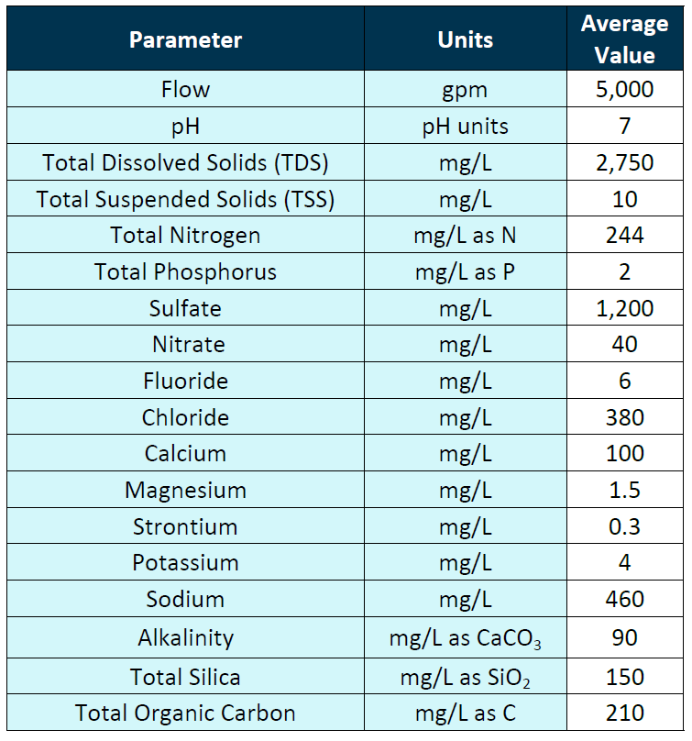
INFLUENT WASTEWATER QUALITY

Slide 3
TREATED WATER QUALITY
Reclaim treated water quality :<75 mg/l of TDS
Brine TDS concentration is >230,000 mg/L, followed by ZLD system

Slide 4
Micron Boise - Lab Testing

Slide 5
Objectives of lab trials
The objectives of the present study
To identify the maximum recovery that can be able to achieve through the ROi stage 1 & CFRO stage 2
To determine the dosage of chemicals required for SCE stage 1 and stage 2 that is needed to bring down Silica, Hardness, and fluoride levels to the required concentrations.

Slide 6
Experimental procedures
Prepared synthetic water according to the feed water parameters
Performed water analysis using Inductively Coupled Plasma Optical Emission Spectroscopy (ICP-OES), Ion Chromatography (IC), and other techniques to confirm feed water parameters
Performed membrane and antiscalant projections to predict maximum recovery
Identified the initial chemical dosages through the OLI and other software

Slide 7
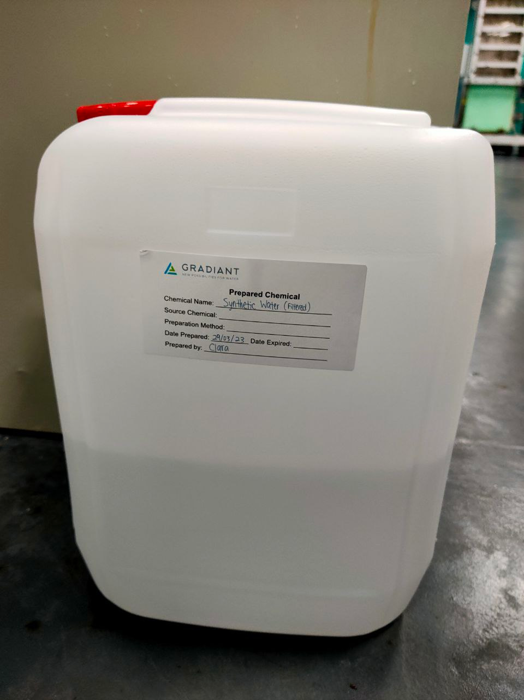
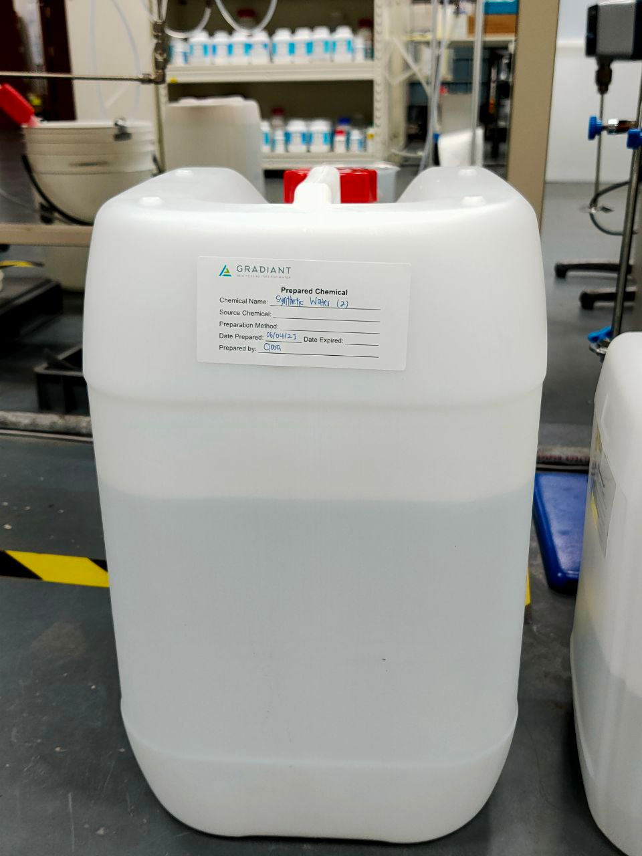
Experiments: SCE Stage 1 Scheme followed: - Jar Testing

Slide 8
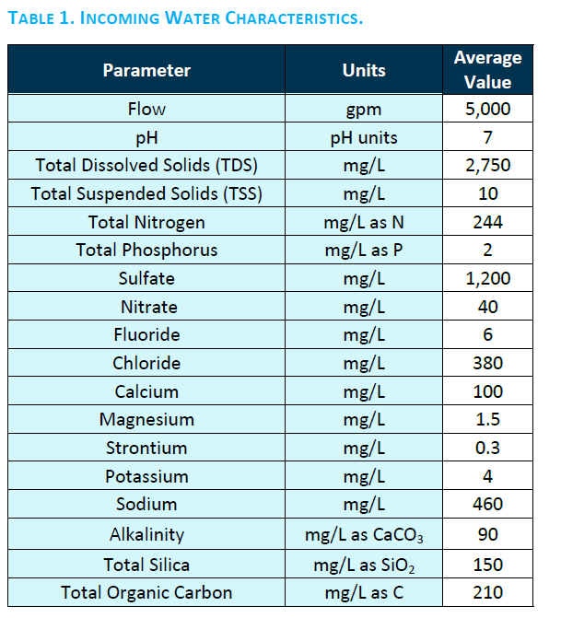
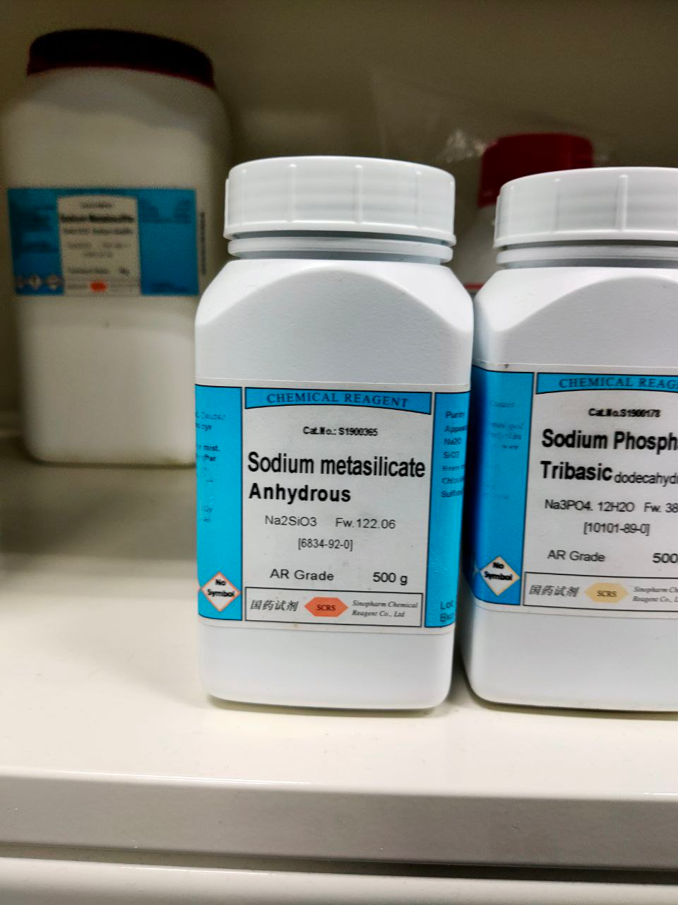
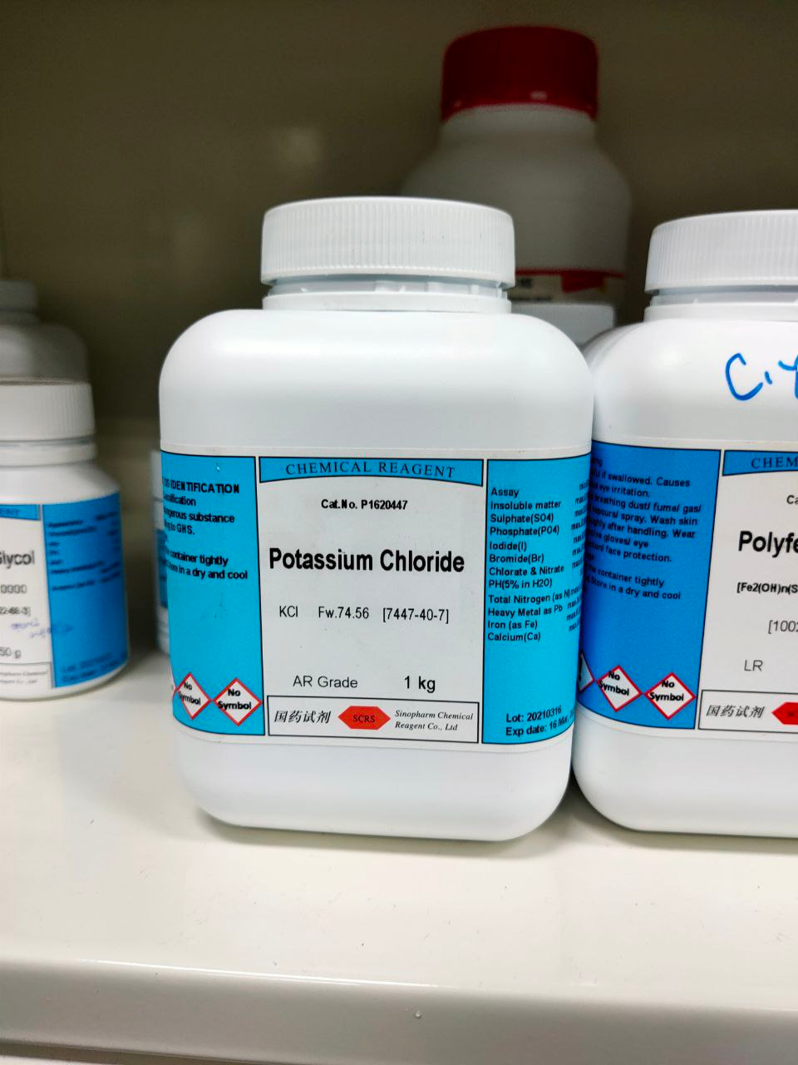
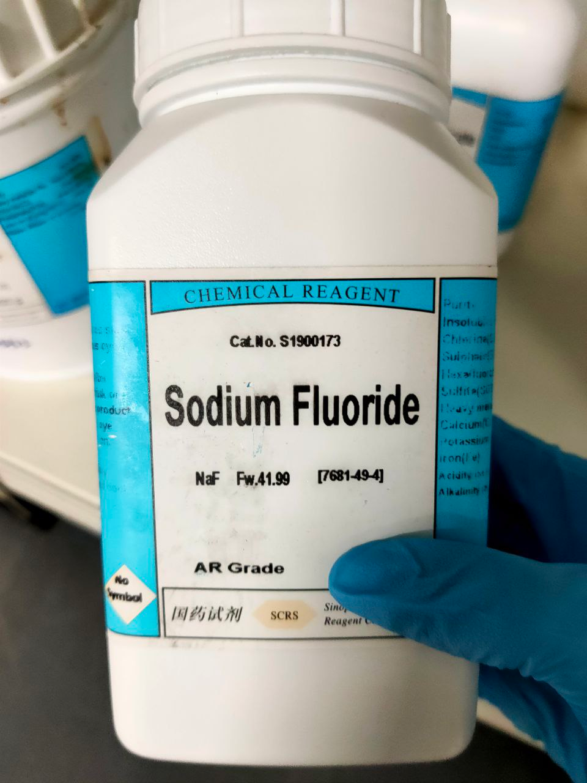
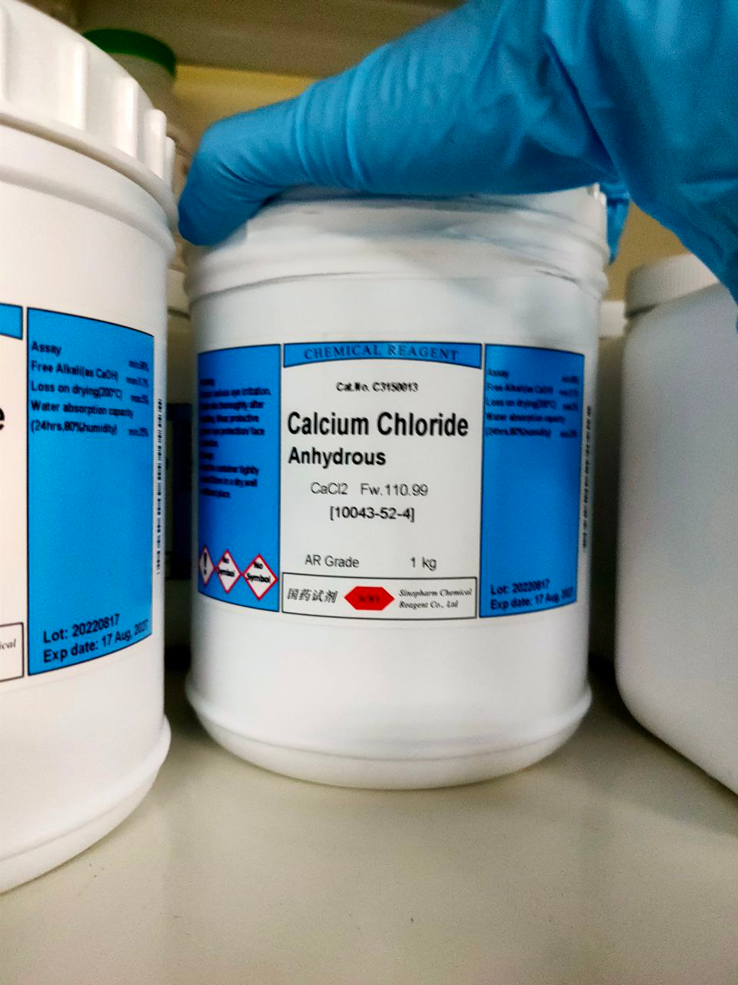
SCE Stage1 Experiment: Synthetic Feed Water Preparation
Salts were added to prepare synthetic water
 |  | Quantity required, (g/L) | mg/L | 10L (mg) | 20L (mg)
1 | SrSO4 | 0.000629 | 0.629 | 6.289 | 12.578
2 | Na2SiO3 | 0.304731 | 304.731 | 3047.308 | 6094.616
3 | NaF | 0.013261 | 13.261 | 132.608 | 265.215
4 | NaHCO3 | 0.090000 | 90.000 | 900.000 | 1800.000
5 | KCl | 0.007628 | 7.628 | 76.275 | 152.550
6 | NaCl | 0.271301 | 271.301 | 2713.014 | 5426.028
7 | MgSO4 | 0.007428 | 7.428 | 74.279 | 148.558
8 | Na2SO4 | 0.532317 | 532.317 | 5323.173 | 10646.346
9 | CaCl2 | 0.376747 | 376.747 | 3767.469 | 7534.939
10 | (NH4)2SO4 | 1.150350 | 1150.350 | 11503.502 | 23007.003
11 | Na3PO4.12H2O | 0.008005 | 8.005 | 80.051 | 160.102
12 | NaNO3 | 0.054831 | 54.831 | 548.311 | 1096.621

Slide 9
Jar Testing protocols (FeCl3)
A beaker of 500ml of synthetic water is dosed with different concentrations of FeCl3
Once dosed, the mixture was rapidly mixed (200 rpm) for the 30s, & followed by slow mixing (100 rpm) for 45 min, pH was measured and adjusted to 8.5 every 15 min
Mixing was stopped and the solids were left to settle for over 90 min, allowing the sludge to settle
The supernatant and sludge were collected for analysis

Slide 10
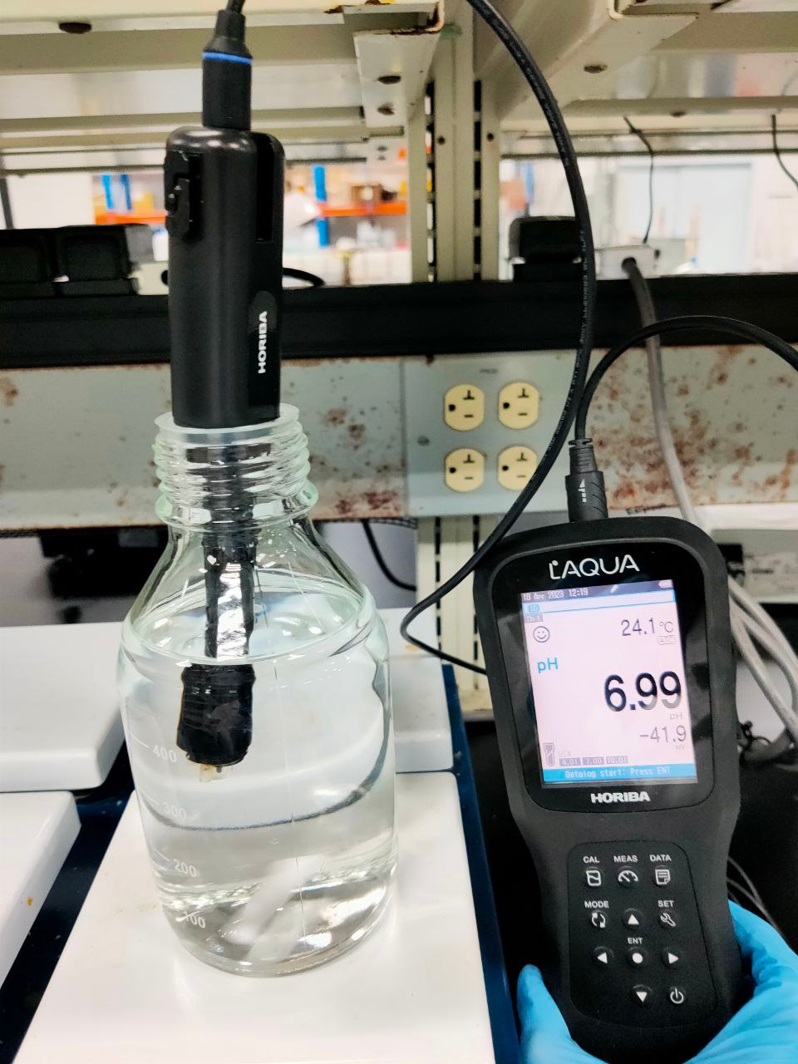
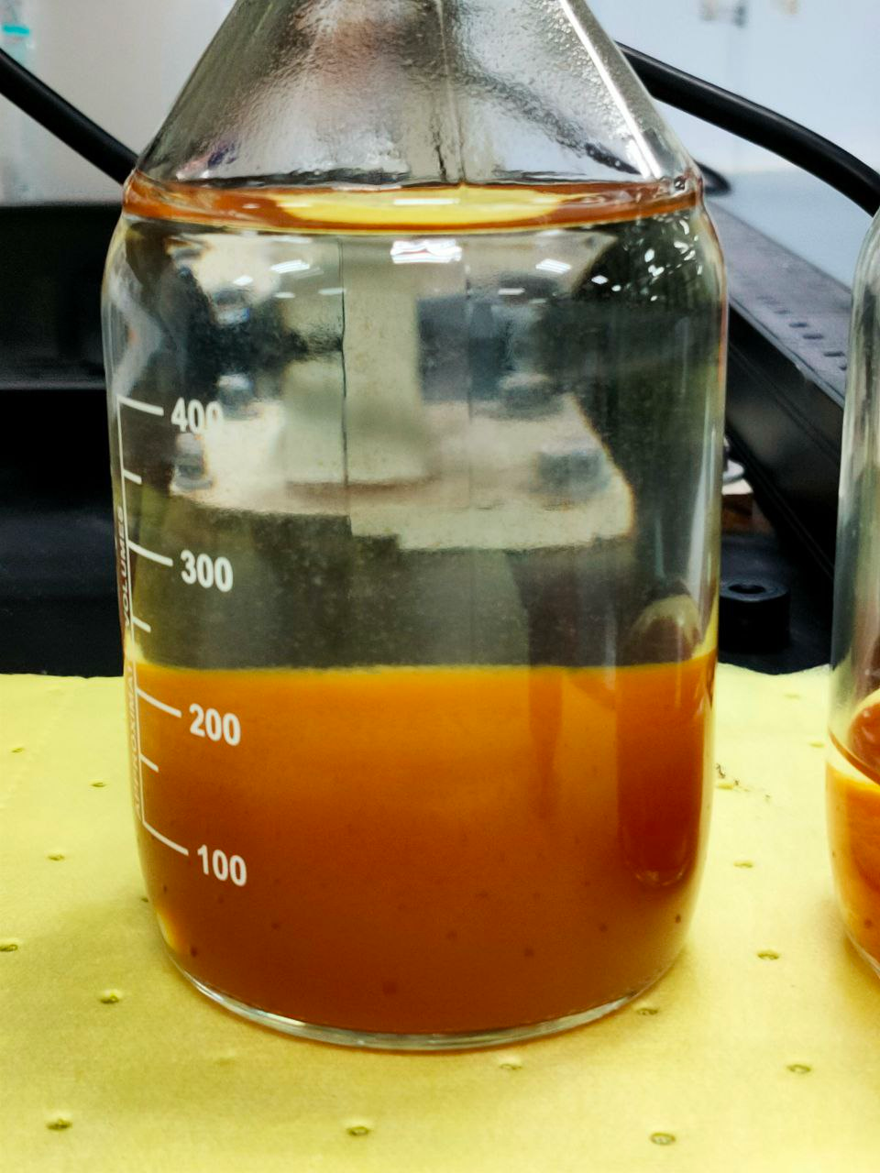
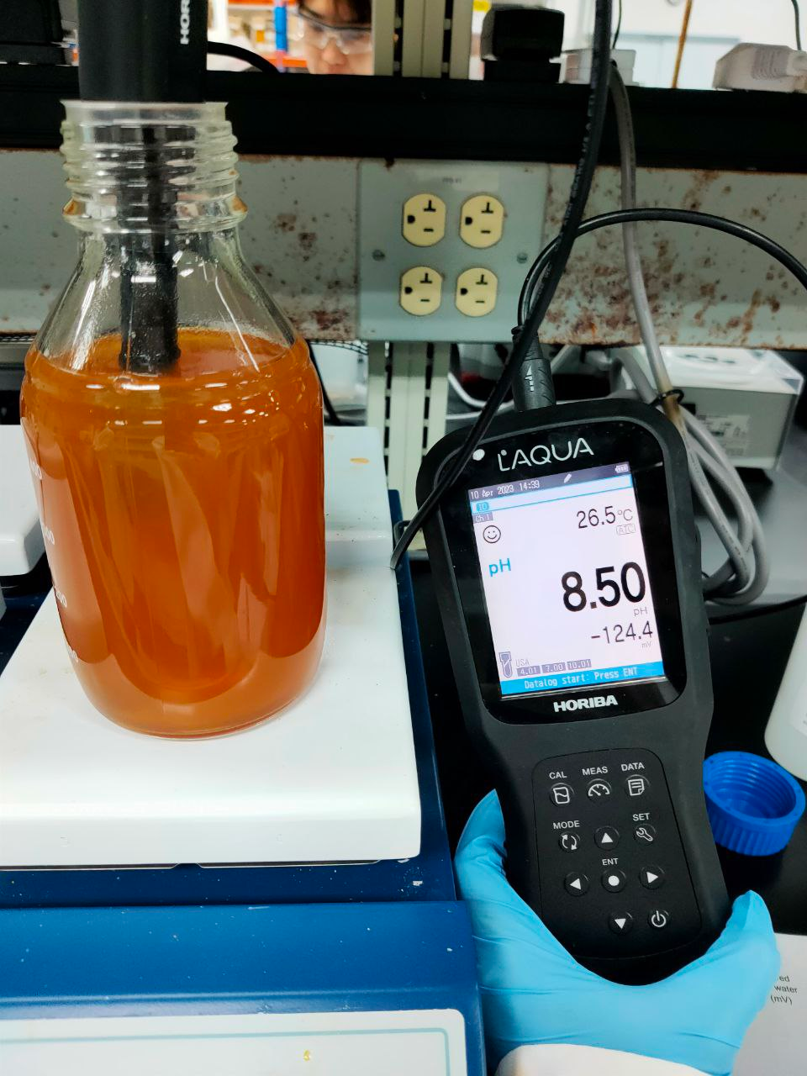
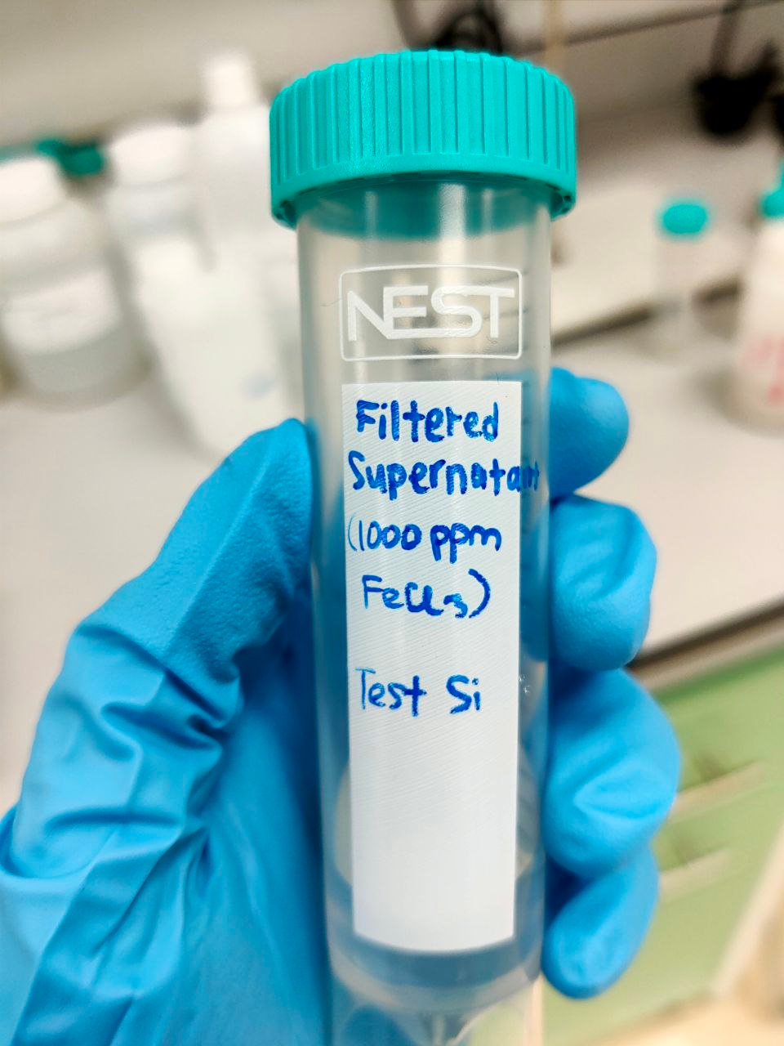
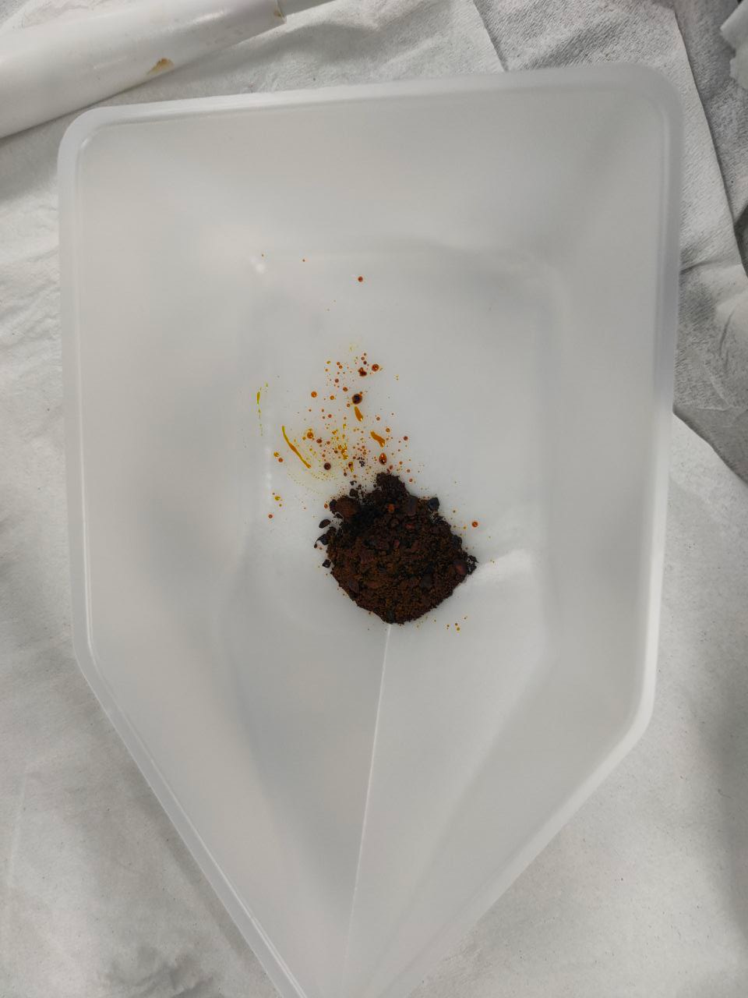
Experimental pictures: Jar Testing (FeCl3)
Feed Water adjusted to pH 7 by dosing HCl and NaOH
FeCl3 was weighed
Sludge was left for settle for >90min
Supernatant was collected, filtered, and sent for analysis

Slide 11
SCE STAGE 1- Jar Testing Treated Water Analysis
 | Units | Feed | Jar
pH | - | 6.96 | 8.45
Fluoride as F | ppm | 4.73 | 4.93
Chloride as Cl | ppm | 369 | 837
Sulphate as SO4 | ppm | 1132 | 1035
Nitrate as NO3 | ppm | 37 | 33.7
Calcium as Ca | ppm | 98.6 | 80.1
Magnesium as Mg | ppm | 0.664 | <0.1
Potassium as K |  | <0.1 | <1
Total Silica as SiO2 | ppm | 136 | 20.9
Sodium as Na |  | 532 | 955
Strontium as Sr |  | 0.2 | 0.2
TOC | ppm | <1 | <1
Ferric chloride was tested, and successfully reduce to ~20ppm using ferric chloride
Filtration was done for pre-treated samples to remove precipitates
Dosage of FeCl3 ~500 mg/l

Slide 12
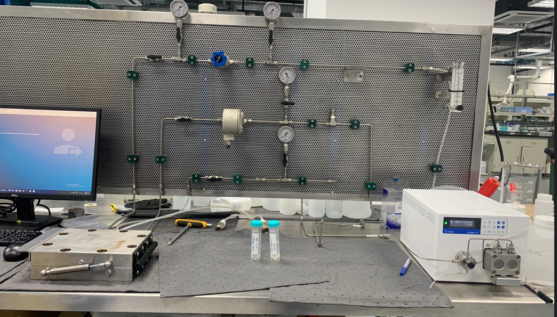
Experiments: ROi Stage 1 Scheme followed: - semi-batch RO

Slide 13
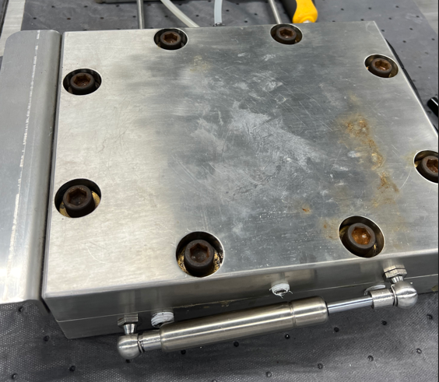
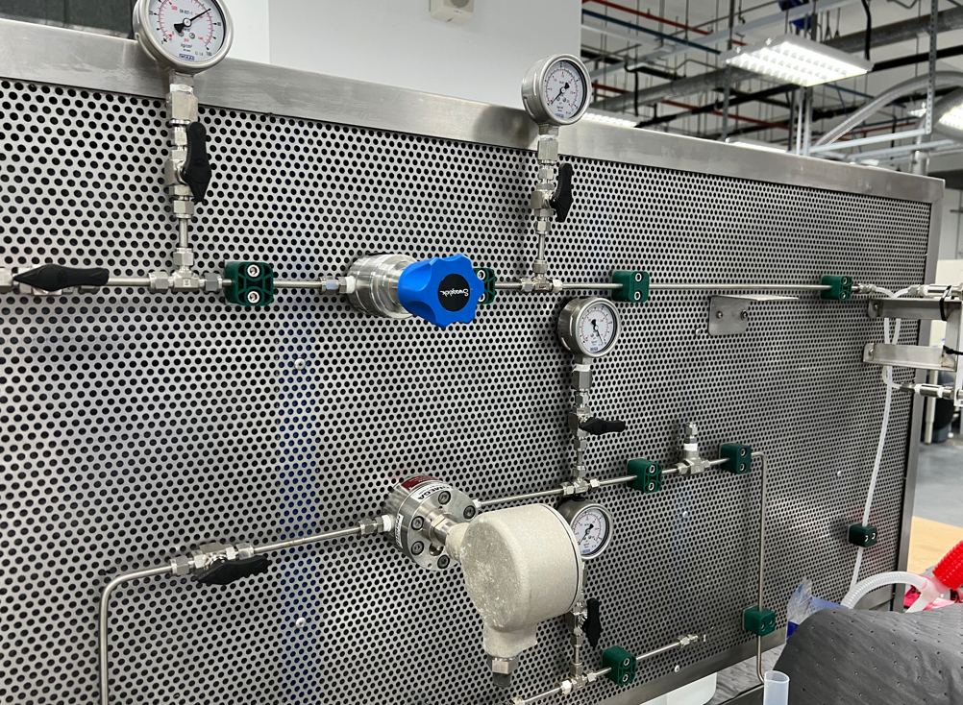
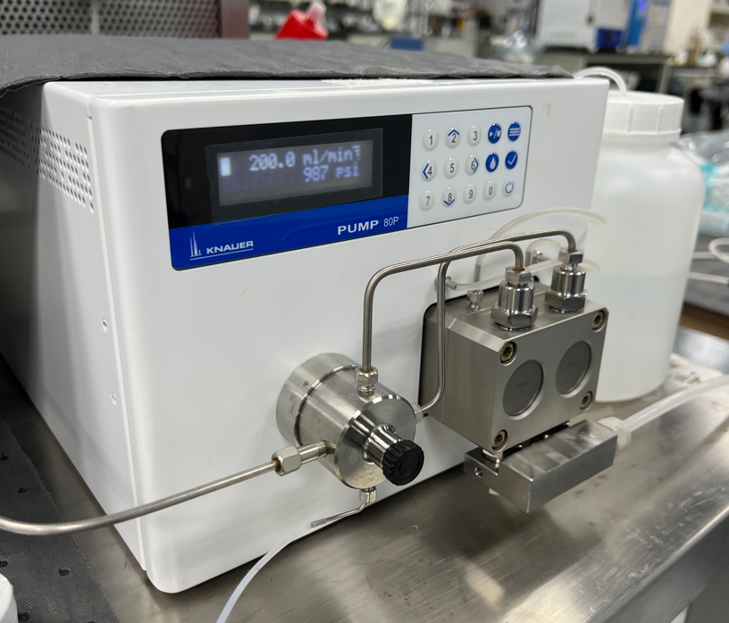
ROi Stage 1 – Lab setup
RO feed stream was concentrated 10x using the micromodule setup and these parameters
Feed pressure: 1000 psi (69 bar)
Flow rate: 200 ml/min
Membrane cell
Instruments
High pressure pump

Slide 14
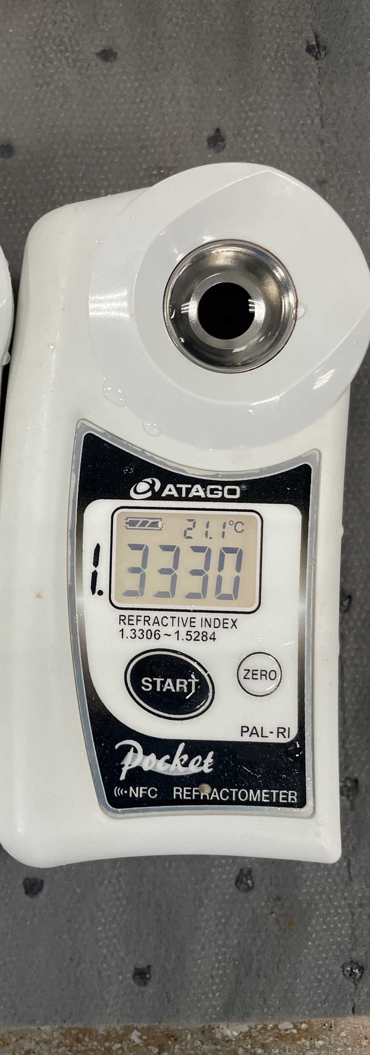
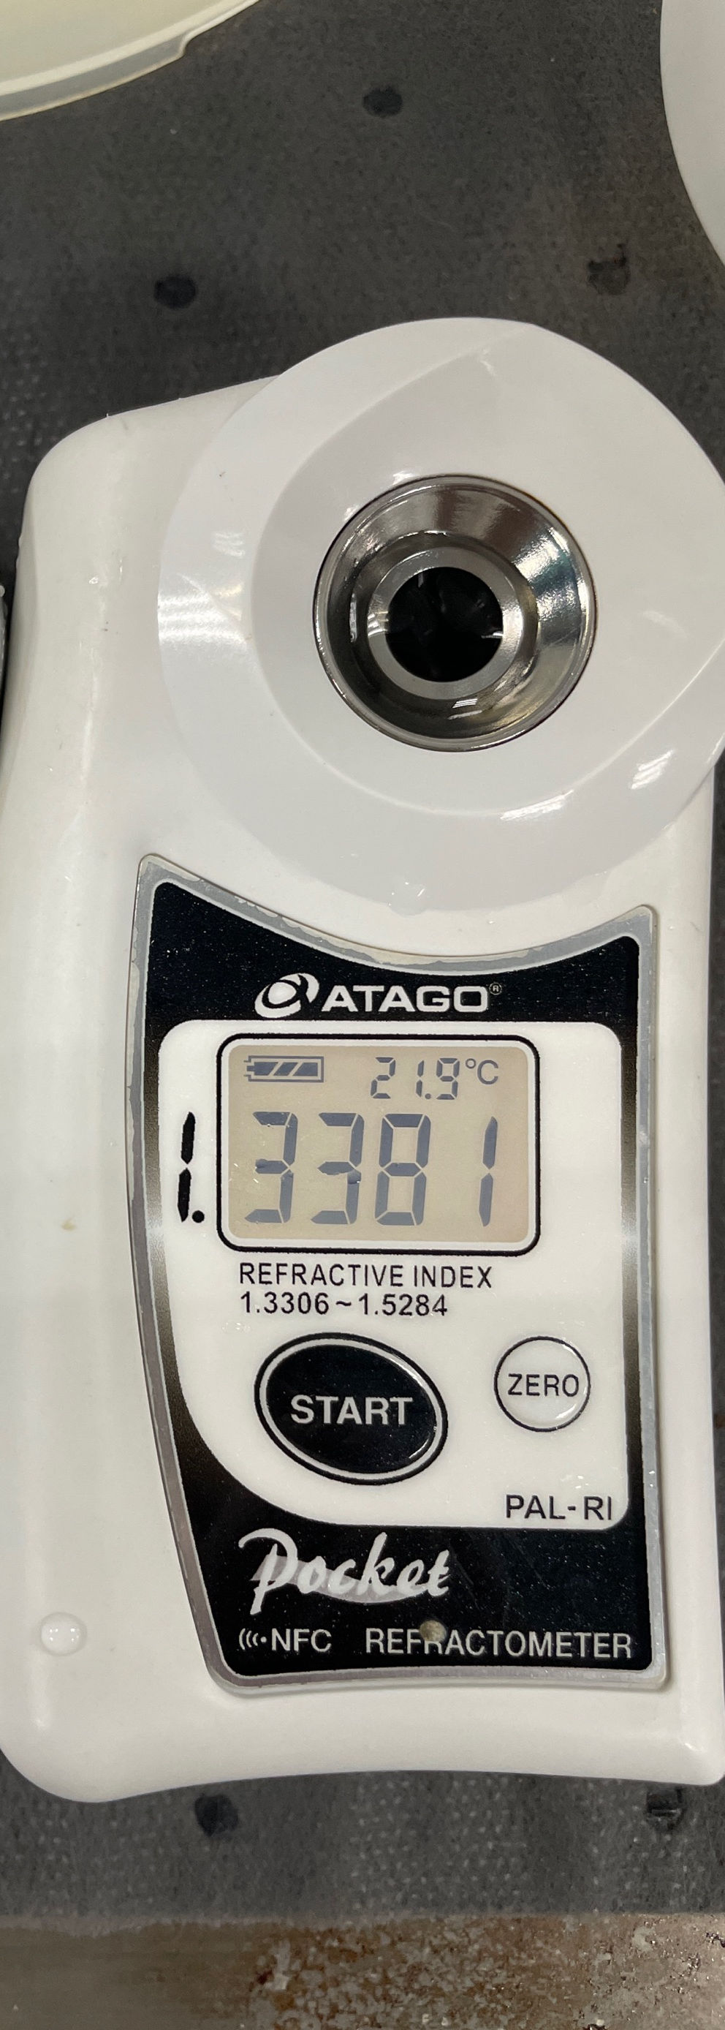
Initial and final concentrations: Refractive Index and TDS
Initial: 2,610ppm TDS
Final: 35,890ppm TDS

Slide 15
ROi Stage 1 : Experimental results
Concentrated TDS of Feed water from 2,610mg/L to 35,890mg/L and achieved ~92.7% recovery.
Parameter | Method | Unit | ROi Feed | ROi Brine | ROi Permeate
Fluoride as F | Ion Chromatography | mg/l | 6.11 | 92.2 | 0.15
Chloride as Cl | Ion Chromatography | mg/l | 378 | 4,712 | 10.9
Sulphate as SO₄ | Ion Chromatography | mg/l | 1,331 | 16,592 | 12.3
Calcium as Ca | EPA200.7 | mg/l | 66.3 | 861 | 0.63
Magnesium as Mg | EPA200.7 | mg/l | 1.9 | 20.9 | <0.1
Potassium as K | EPA200.7 | mg/l | 3.93 | 87.9 | <0.1
Total Silica SiO2 | EPA200.7/ Calculation | mg/l | 20.8 | 340* | <0.1
Sodium as Na | EPA200.7 | mg/l | 790 | 12680 | 21
Strontium as Sr | EPA200.7 | mg/l | 0.63 | 7.51 | <0.1
TDS | APHA 2540C | mg/l | 2,610 | 35,890 | 61.5
pH |  |  | 7.03 | 7.0 | 7.05
Rechecking the silica value
Permeate TDS < 75mg/L

Slide 16
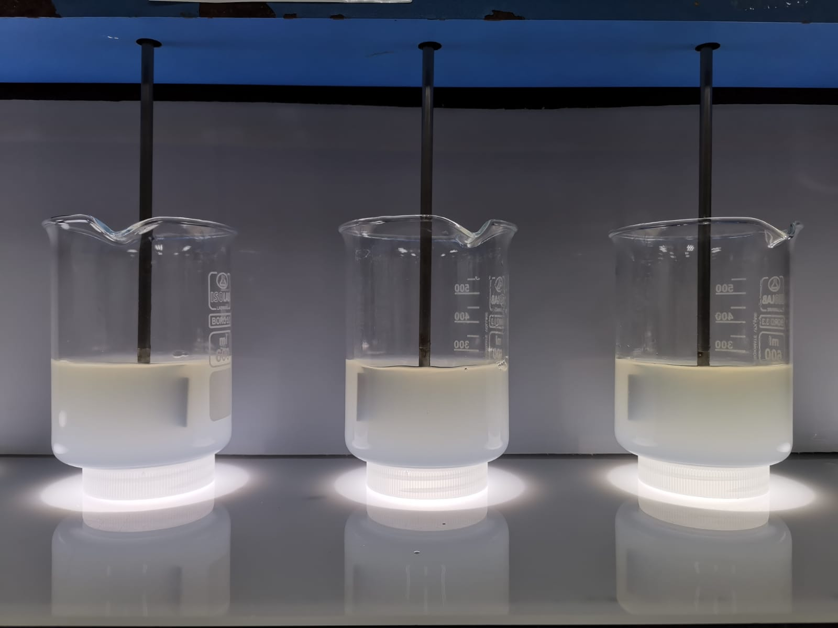
Experiments: SCE Stage 2 Scheme followed: - Jar Testing

Slide 17
SCE stage 2: Jar Testing protocols
A beaker of 500ml of synthetic water is dosed with different concentrations of lime, MgCl2, and Na2CO3
Once the dosage of both was, the mixture was rapidly mixed (200 rpm) for the 30s, & followed by slow mixing (100 rpm) for 45 min, and pH was measured and adjusted to 10.5 every 15 min
1 mg/L of SNF polymer (anionic) was dosed and further slower mix (30 rpm) for 45 min. pH was measured every 15 min
Mixing was stopped and the solids were left to settle for over 90 min, allowing the sludge to settle
The supernatant and sludge were collected for analysis

Slide 18
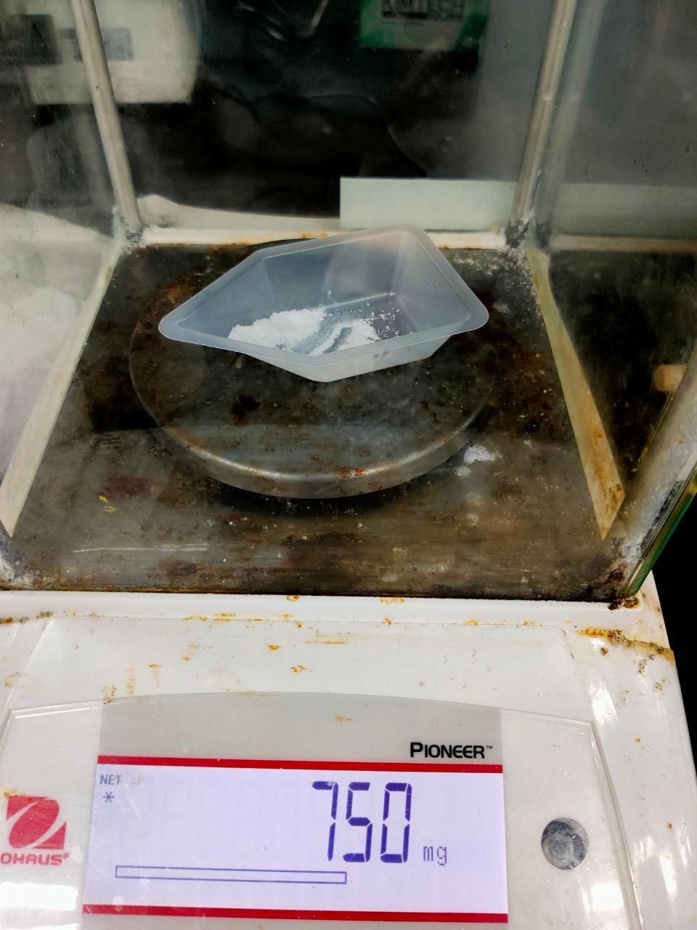
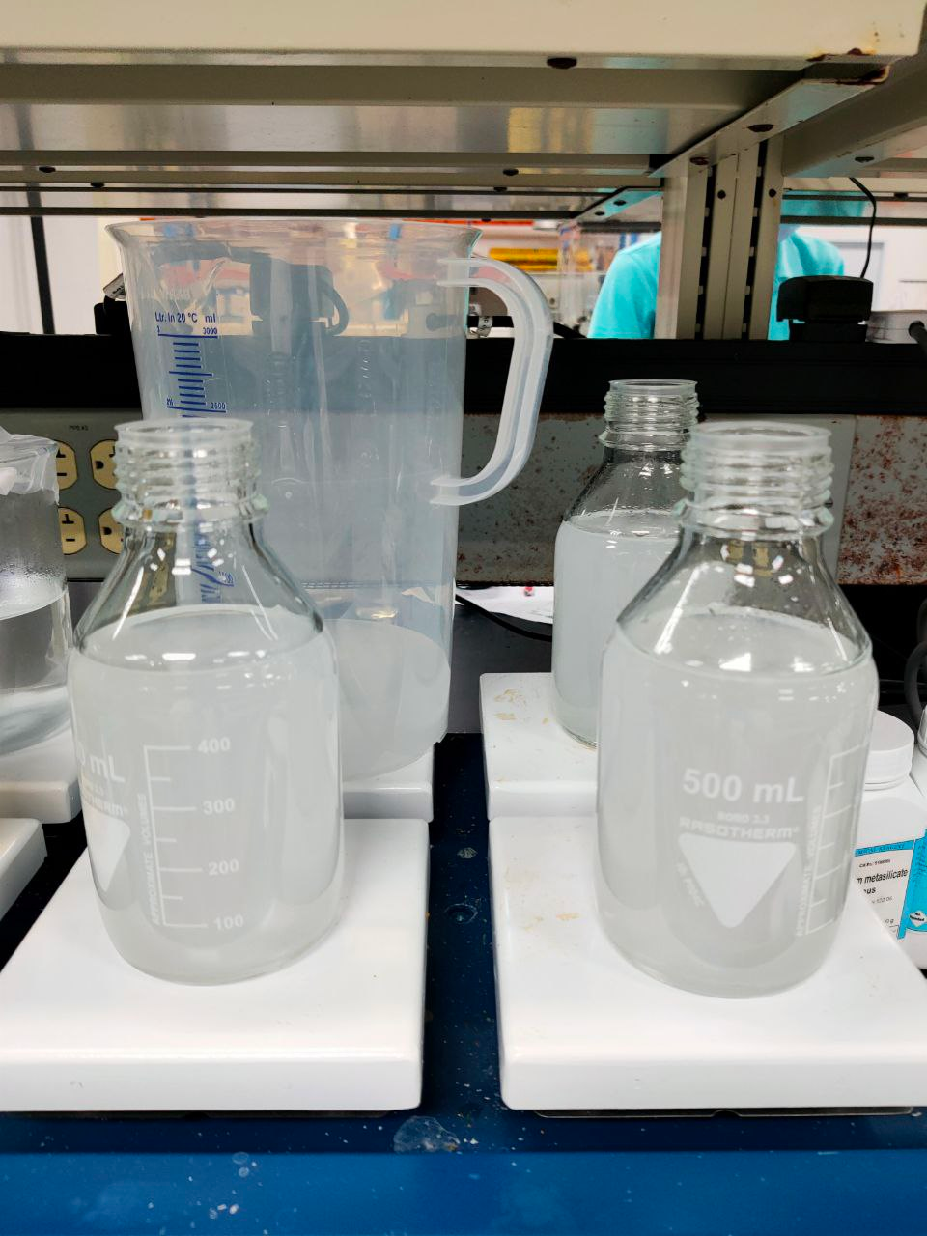
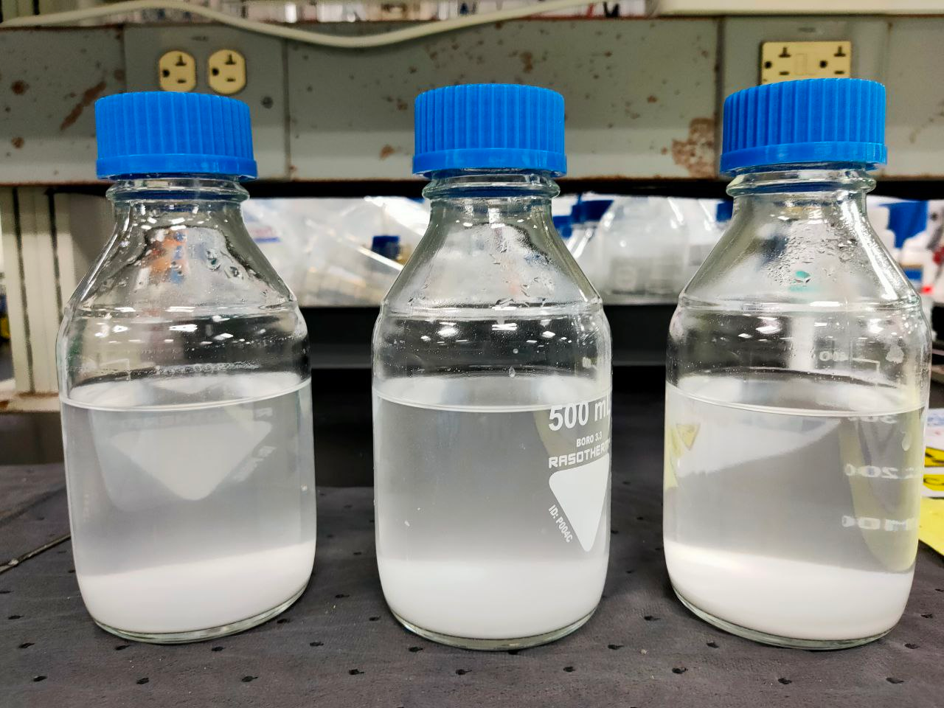
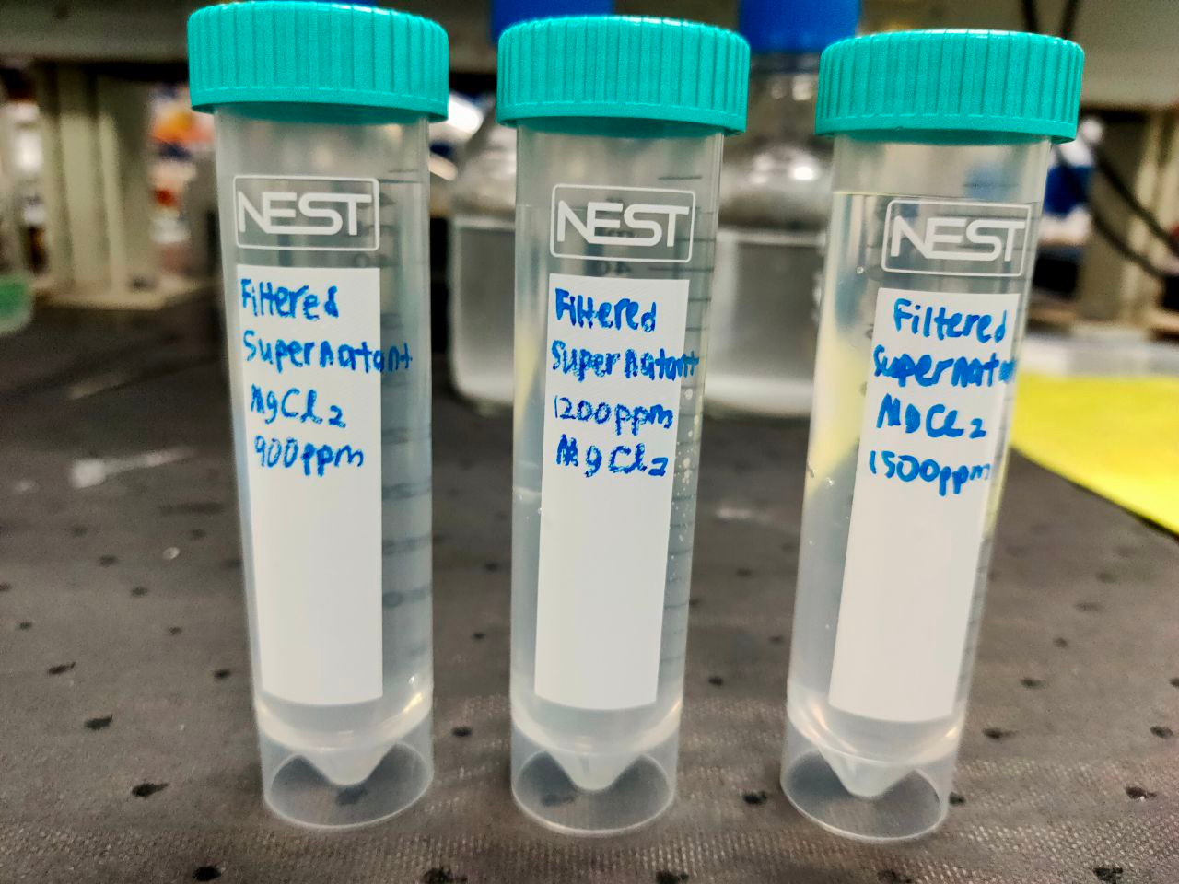
Experimental pictures: Jar Testing stage 2
Feed Water
Chemicals were weighed
Sludge was left for settle for >90min
Supernatant was collected, filtered, and sent for analysis

Slide 19
SCE STAGE 2- Jar Testing Treated Water Analysis
Parameter | Unit | Synthetic Feed | Filtered Supernatant (Dosing 1) | Filtered Supernatant (Dosing 2)
pH |  | 7.93 | 10.36 | 10.62
Total Silica as SiO₂ | mg/l | 293 | 43.7 | 23.8
Fluoride as F | mg/l | 59.9 | 16.8 | 16.9
Calcium as Ca | mg/l | 709 | 38 | 32.6
Potassium as K | mg/l | 119.5 | 114 | 116
Sodium as Na | mg/l | 10,200 | 15,830 | 17,900
Strontium as Sr | mg/l | 2.95 | 0.25 | 0.27
Different chemical dosages were tested and successfully reduced silica to ~23ppm
Dosage was varied from 500 to 1200 mg/l of MgCl2 etc.,

Slide 20
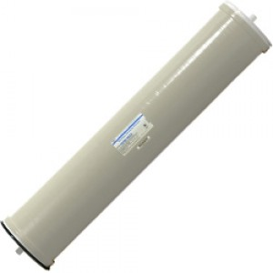
Experiments: CFRO Scheme followed: - CFRO membrane testing

Slide 21
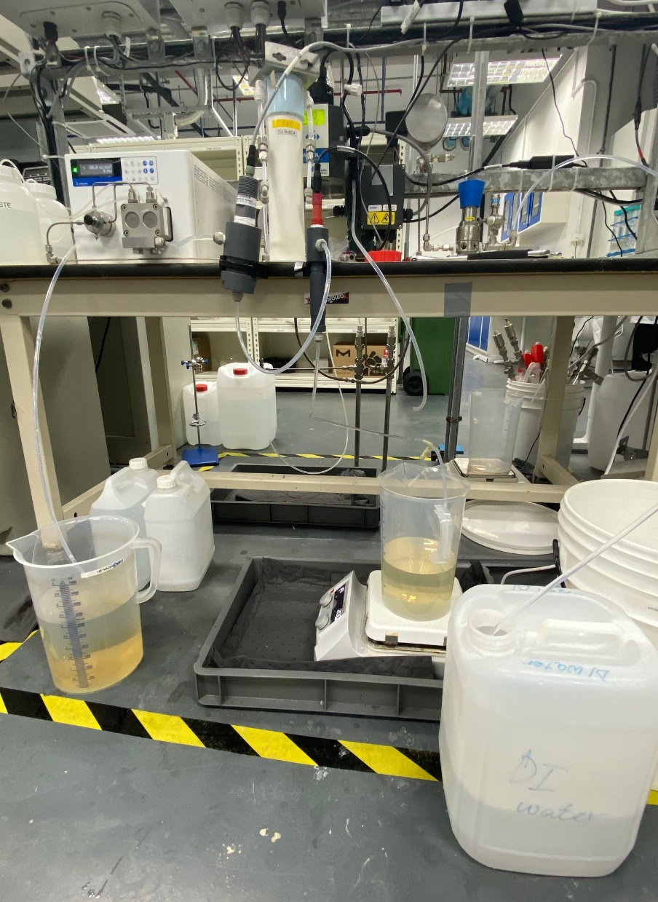
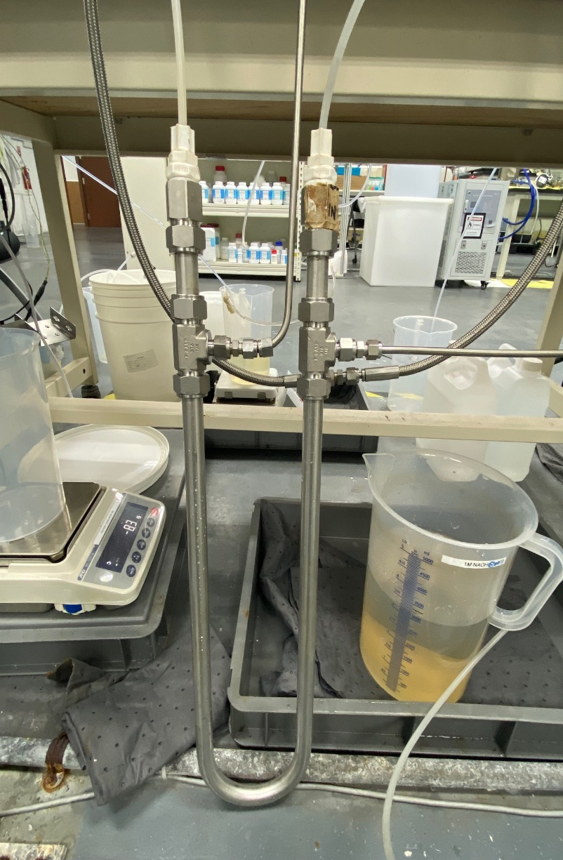
CFRO membrane lab setup
Feed
Operating parameters:
Feed flow: 200 ml/min
Feed operating pressure: 1000 psi
Permeate

Slide 22
CFRO Stage 2 : Experimental results
CFRO successfully concentrating up the feed from 31,020mg/L to >260,000mg/l based on equivalent RI index

Slide 23
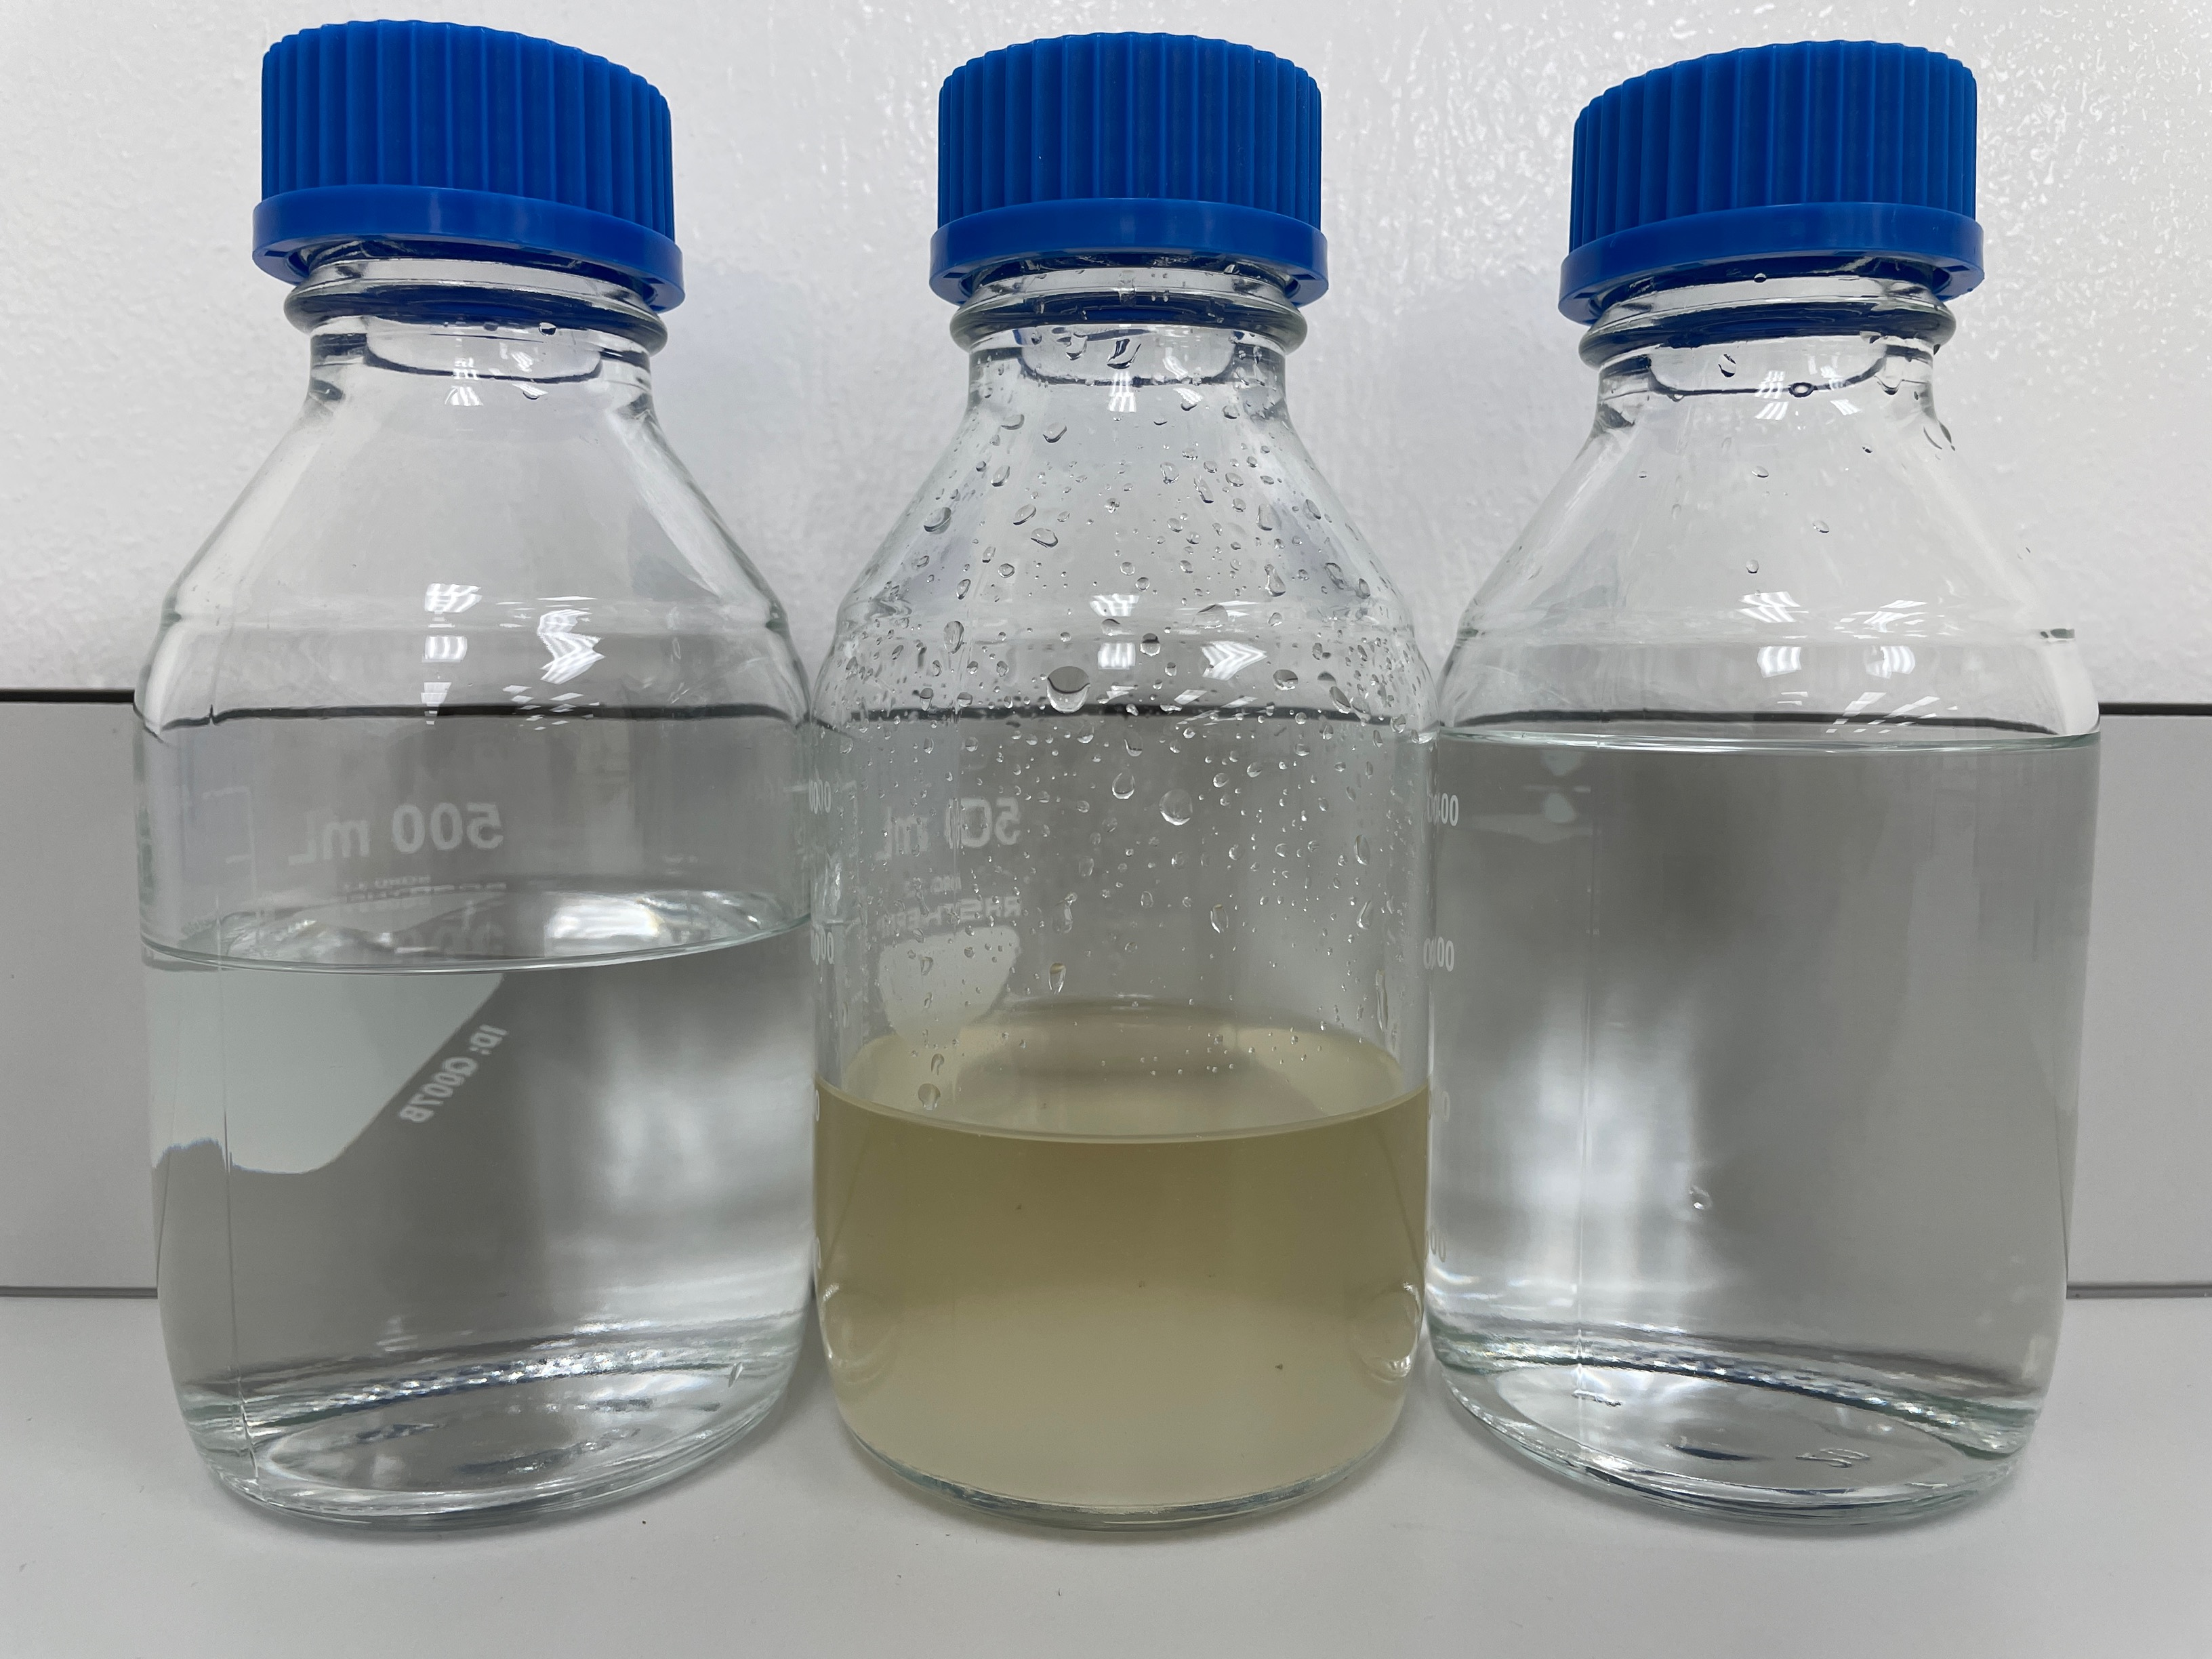
CFRO Stage 2 : Experimental results
Concentrated TDS of CFRO Feed from 31,020 mg/L to 265,600 mg/L and achieved ~88% recovery
Parameter | Method | Unit | Boise CFRO Feed | Boise CFRO Brine Reject
Fluoride as F | Ion Chromatography | mg/l | 13.9 | 140
Chloride as Cl | Ion Chromatography | mg/l | 4,594 | 38,883
Sulphate as SO4 | Ion Chromatography | mg/l | 12443 | 108,724
Calcium as Ca | EPA200.7 | mg/l | 18.6 | 209
Magnesium as Mg | EPA200.7 | mg/l | 12.6 | 166
Potassium as K | EPA200.7 | mg/l | 150.2 | 536
Total Silica SiO2 | EPA200.7/ Calculation | mg/l | 23 | 263
Sodium as Na | EPA200.7 | mg/l | 13,280 | 92,080
Strontium as Sr | EPA200.7 | mg/l | 3.9 | 27.5
TDS | APHA 2540C | mg/l | 31,020 | 265,600
PH | Ph probe |  | 7.25 | 7.9

Slide 24
Experiments: Zero Liquid Discharge Scheme followed: - Adiabatic Chiller, CGE and Crystallizer/Centrifuge

Slide 25
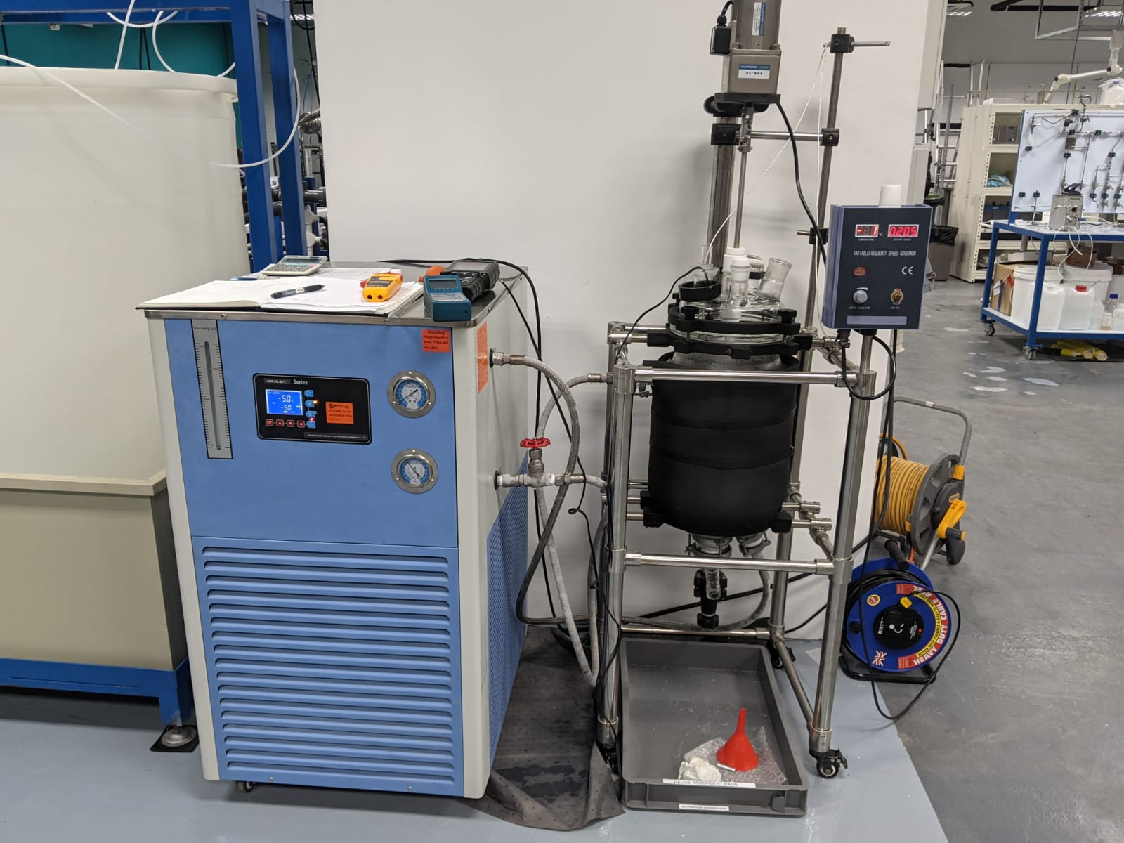
Test objective using Adiabatic Chiller/Centrifuge
The objective of the adiabatic chiller and centrifuge experiment is to produce the sodium sulfate rich salts from the CFRO brine.

Slide 26
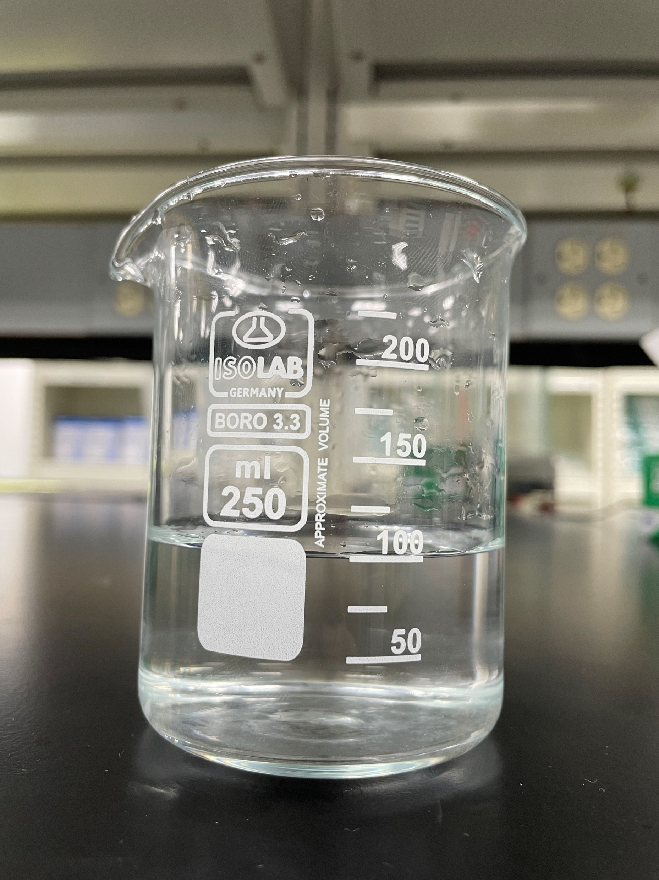
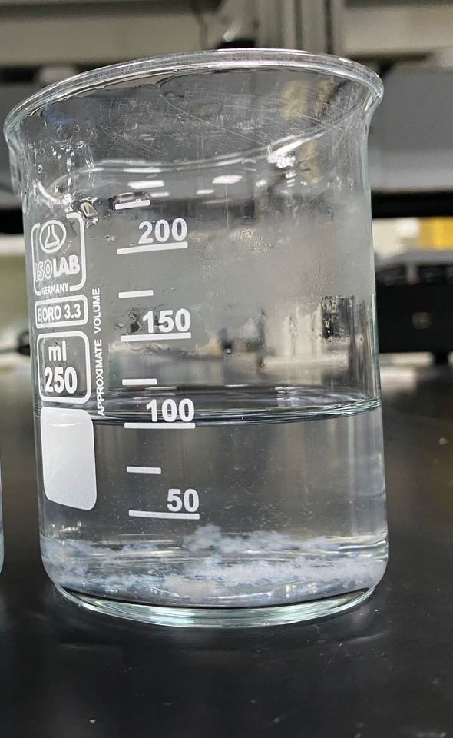
Adiabatic Chiller: Experimental procedures
Using a chiller cool down the water bath temperature to about 1˚C
Soak the concentrated brine sample (TDS: 260,000 mg/l) in the cool water bath – monitor the change in sample temperature.
Concentrated brine at room temperature.
Concentrated brine after cooling to 2.2˚C.

Slide 27
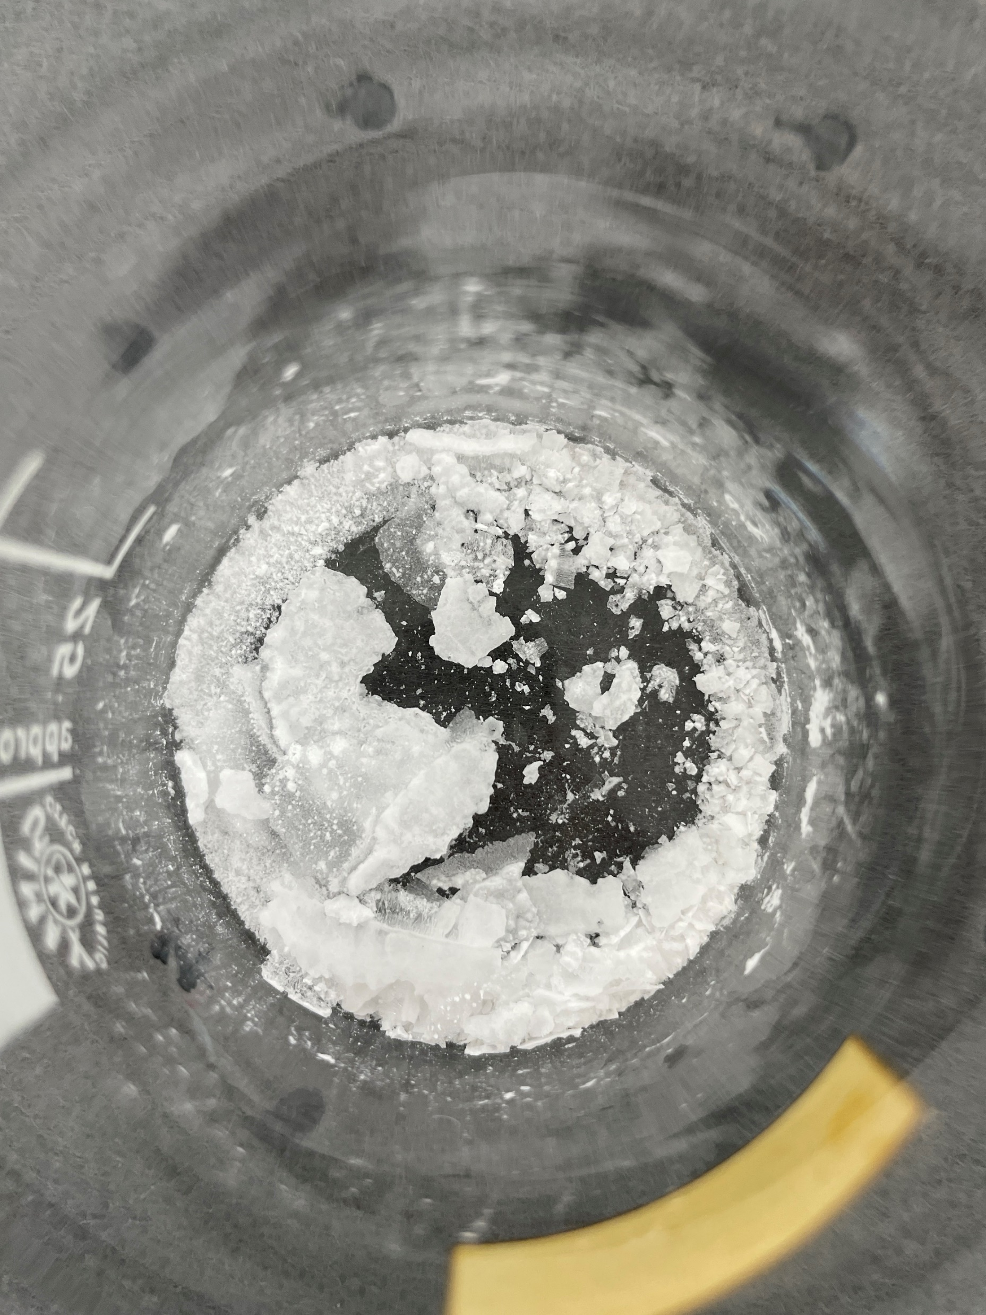
Centrifuge/Crystallizer: Experimental results
Parameter | Sodium sulphate rich stream
Fluoride as F | 0.0%
Chloride as Cl | 5.5%
Phosphate as PO₄ | 0.0%
Sulphate as SO₄ | 55.0%
Nitrate as NO₃ | 0.0%
Calcium as Ca | 0.0%
Magnesium as Mg | 0.0%
Potassium as K | 0.2%
Total Silica SiO2 | 0.0%
Sodium as Na | 39.2%
Strontium as Sr | 0.0%
Salts after centrifuge, from sodium sulphate rich stream

Slide 28
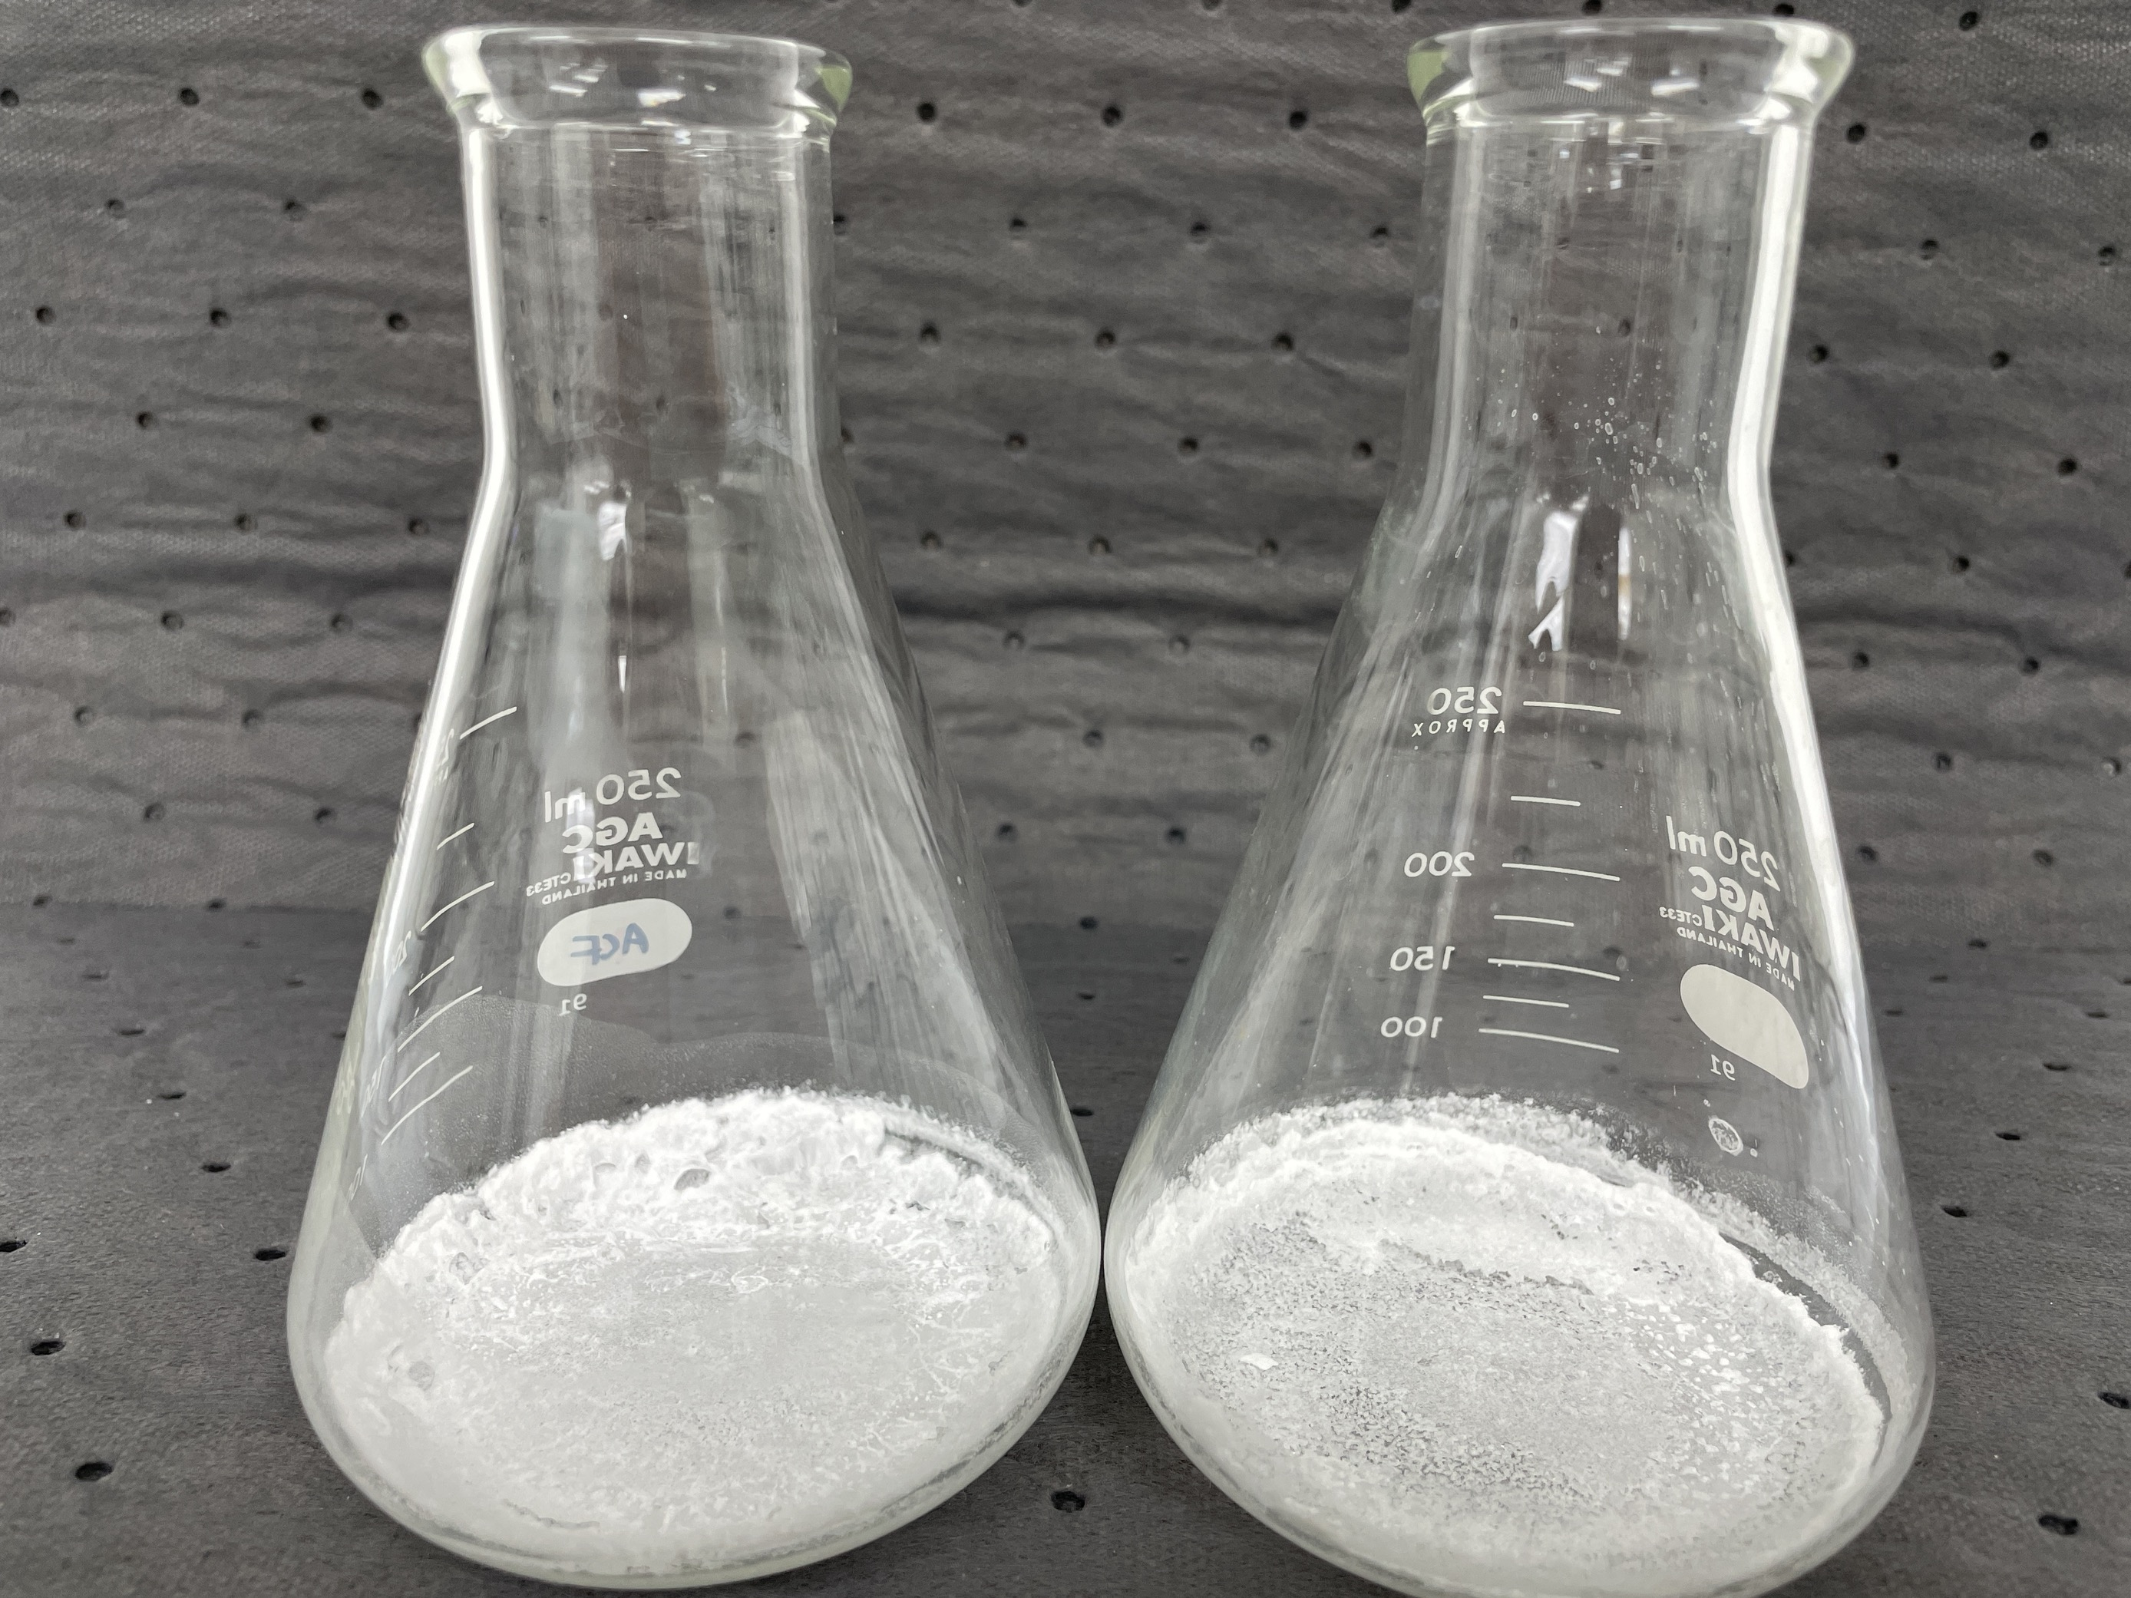
CGE and ATFD for Mixed salts: Experimental results
Parameter | Mixed salts
Fluoride as F | 0.1%
Chloride as Cl | 24.4%
Phosphate as PO₄ | 0.0%
Sulphate as SO₄ | 37.5%
Nitrate as NO₃ | 0.0%
Calcium as Ca | 0.1%
Magnesium as Mg | 0.1%
Potassium as K | 4.9%
Total Silica SiO2 | 0.1%
Sodium as Na | 32.8%
Strontium as Sr | 0.0%
Mixed salt after ATFD

Slide 29
Conclusion/summary
Successfully achieved the target concentration of brine >230000 mg/l using ROi stage 1 and stage 2 membrane technology.
Met the reclaimed treated water quality: <75 mg/L of TDS.
Identified the optimized dosage of chemicals to reduce the scaling and maximize the recovery.
Conducted the Adiabatic chiller, CGE, and ATFD/centrifuge experiments to validate the sodium sulfate-rich salts and mixed salts.

Slide 30
Back up

Slide 31

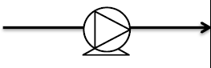
PFAS Removal Technology
Foam Fractionation - Separation
Electrochemical Oxidation (EO) - Destruction
Foam Fractionation
Electrochemical Oxidation (EO)
PFAS Destruction
PFAS Feed water
GAC/IX
(Polishing)
GRADIANT CONFIDENTIAL

Slide 32
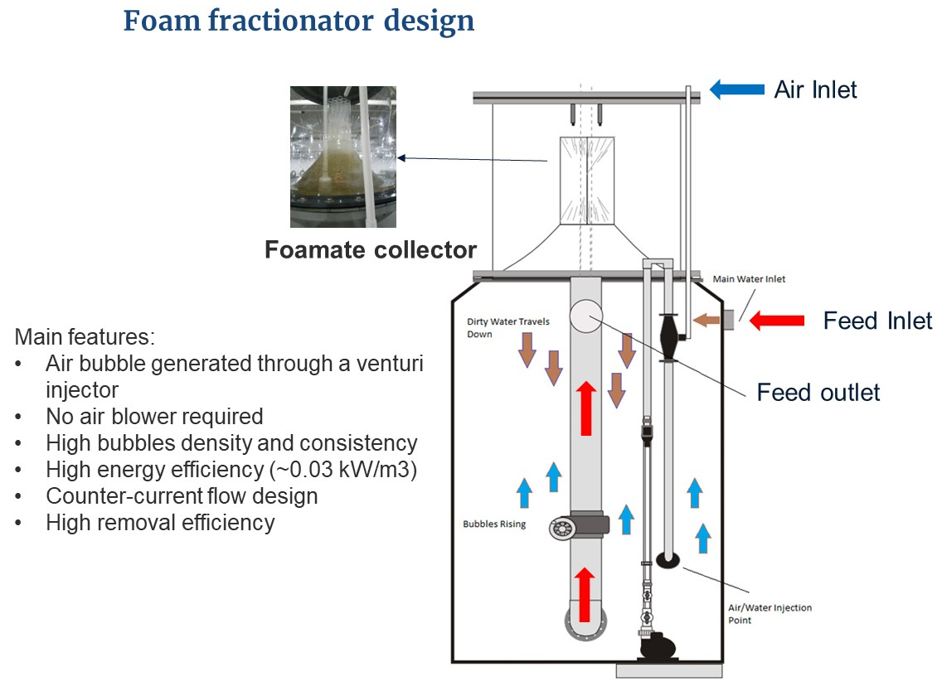
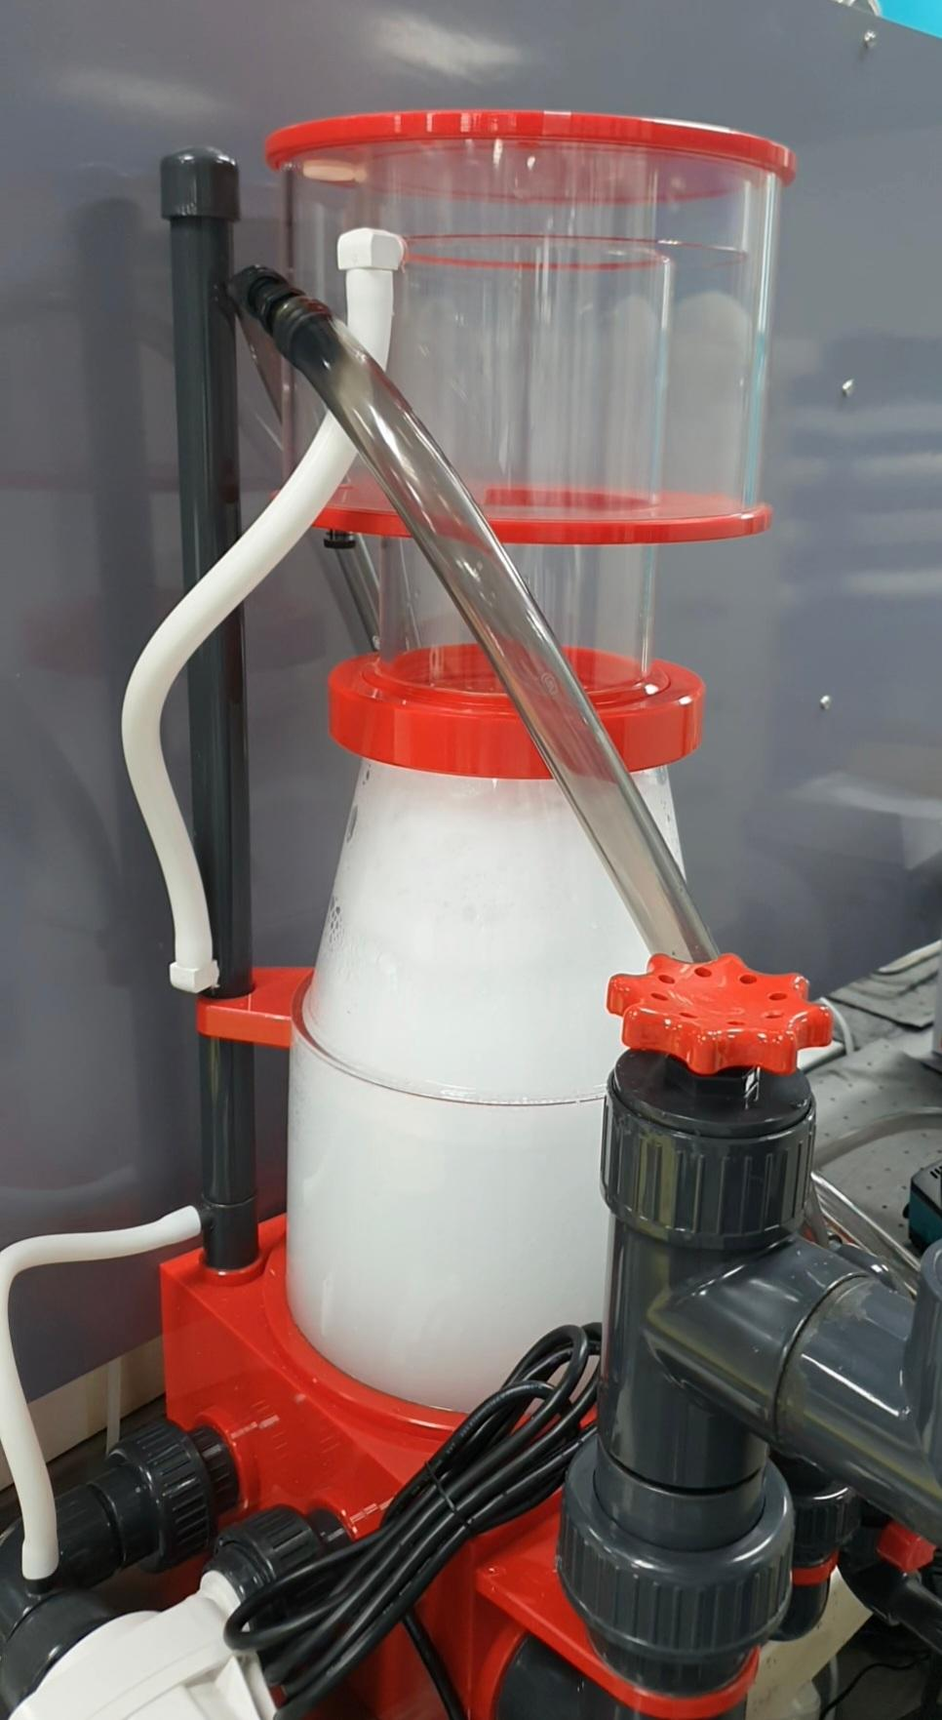
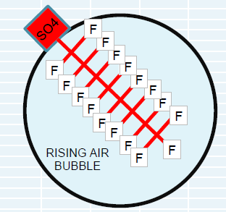
Foam fractionation - Separation
It is the state-of-the-art technology that uses adsorption-based technique to create many air-liquid interfaces within the solution to achieve PFAS removal. The surface-active PFAS compounds will be adsorbed onto these air-liquid interfaces and separated from waste stream.
Fig. 1. Lab-scale setup for bench testing for various wastewater matrix.

Slide 33
Benefits
Foam fractionation has the potential to achieve more than 10X concentration factor (equivalent to > 90% volume reduction of waste stream for downstream EO destruction step) at a fraction of the cost compared to other conventional PFAS removal technologies.
Separation
Concentration
Destruction
Benefits:
Simpler to O&M & modularization
Easier deployment
Low chemical consumption
Low energy requirement
Low competition with co-contaminants
Fig.2. OPEX ($/m3) comparison among other PFAS removal technologies.

